Slide 1
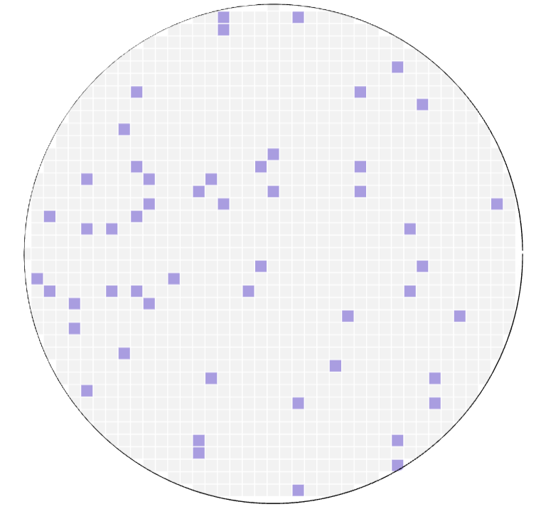
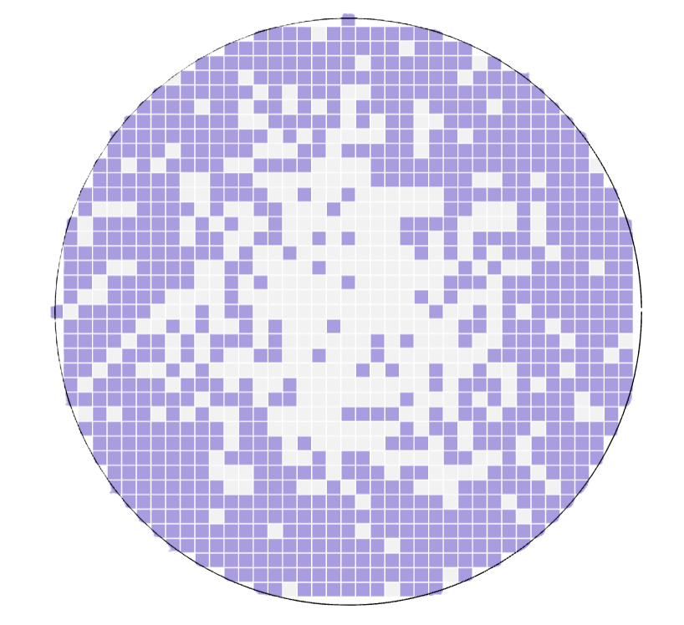
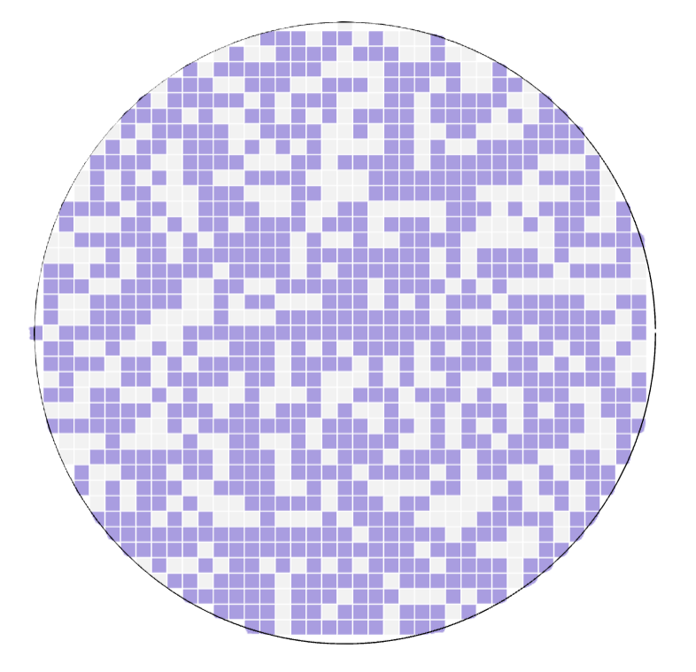
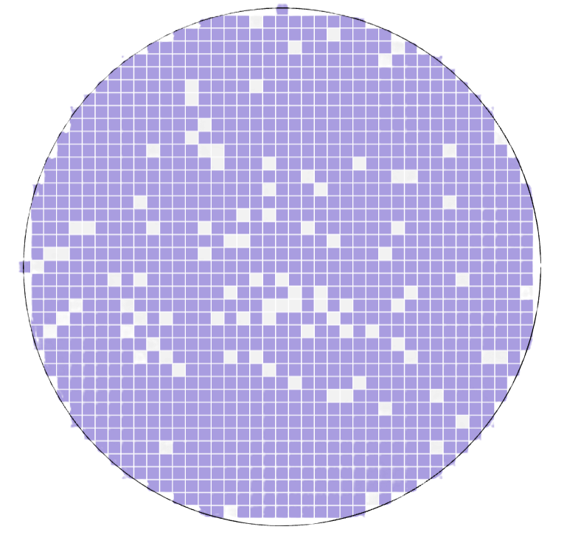
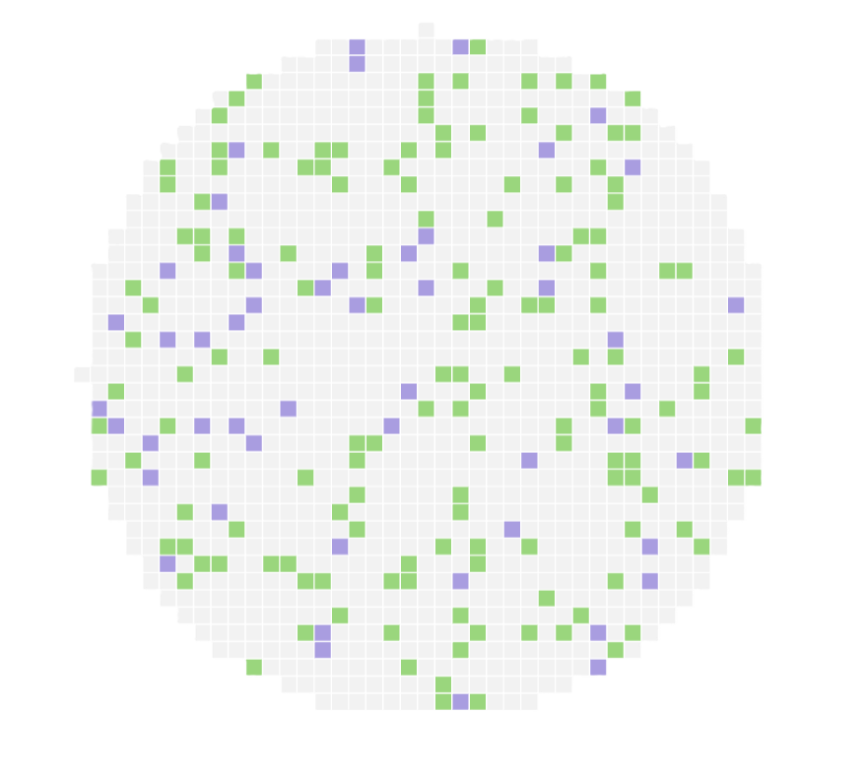
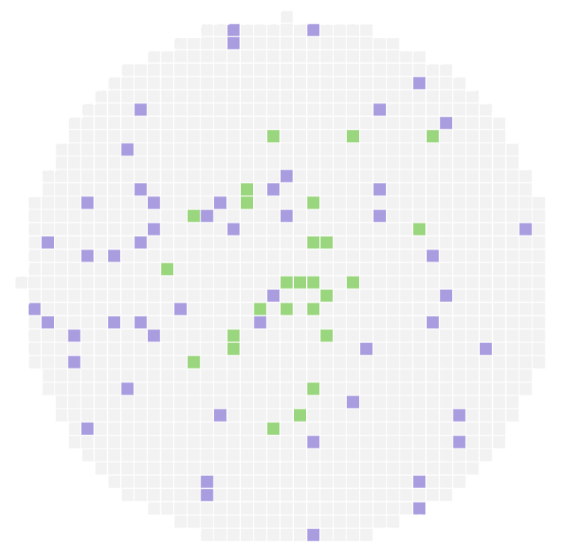
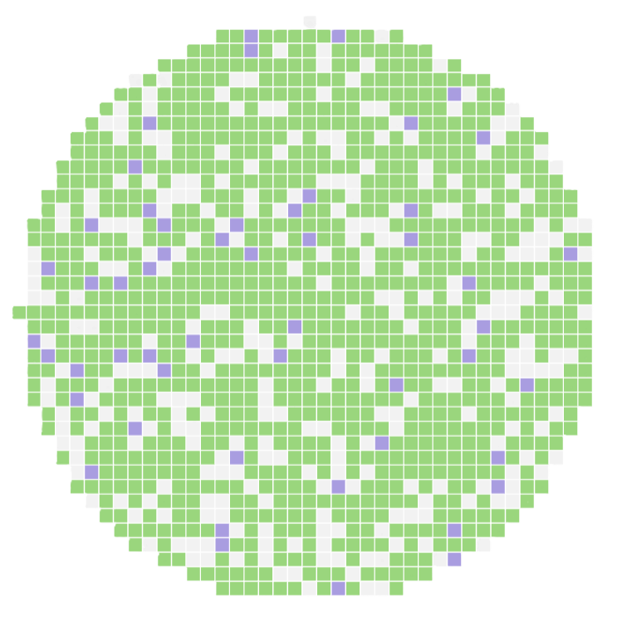
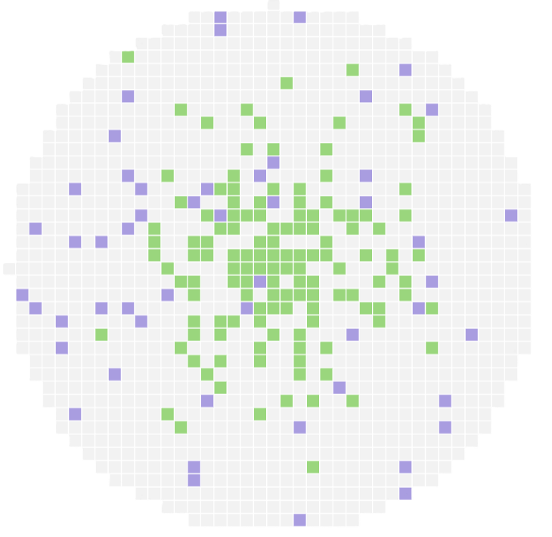
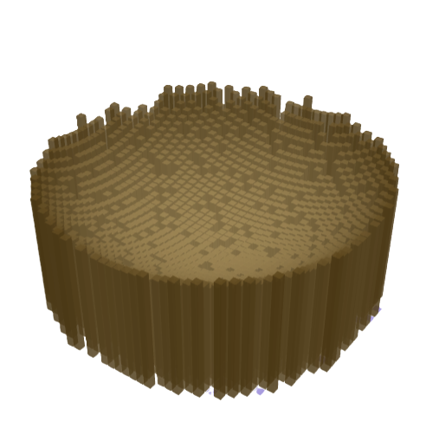
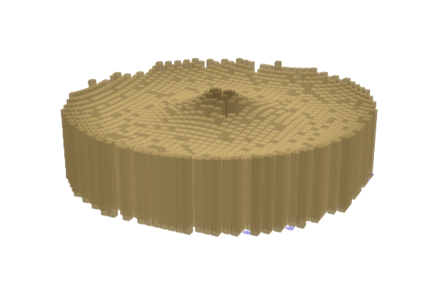
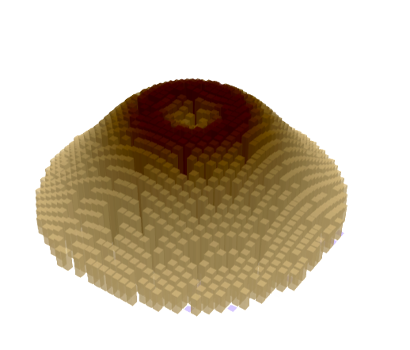
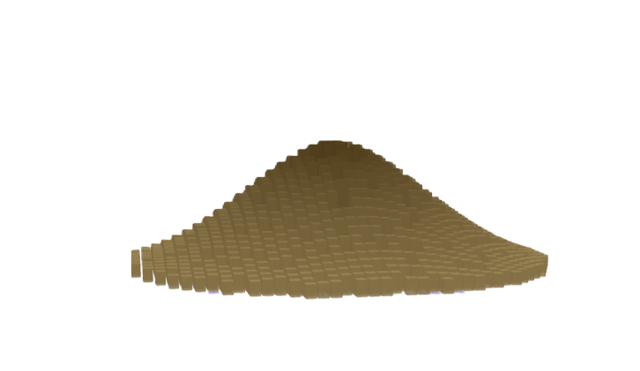
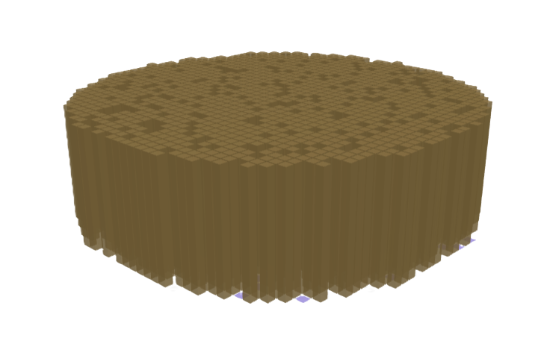







(a) Horizontal Constraints Types
Structural Zeros (cannot be constructed)
Constructable Area
$$ψ\left(r\right)=logistic(α+β∙r)$$
$α$ small, $β$small
$α$ small, $β$large
$α$ large, $β$small
$α$ large, $β$large
Uniformly Open
Edge constrained
Uniformly constrained
Locked
(b) Horizontal Construction Types
Buildings
Structural Zeros
Constructable Area
$π (r)=logistic(κ−δ∙r)$
κ small δ small
κ small δ large
κ large δ small
κ large δ large
Uniformly sparse
Thinly built
Uniformly dense
Core-dense
(c) Vertical Profile Types
$$H(r)=A∙exp(Br+Cr^{2})$$
C>0, B>0
“Bowl” City
C>0, B<0
“Crown”City
C=0, B=0
“Pancake” City
C<0, B>0
“Volcanic Cone” City
C<0, B<0
“Pyramid”City
H
H
H
H
H
0
r
0
r
0
r
0
r
0
r

Slide 2




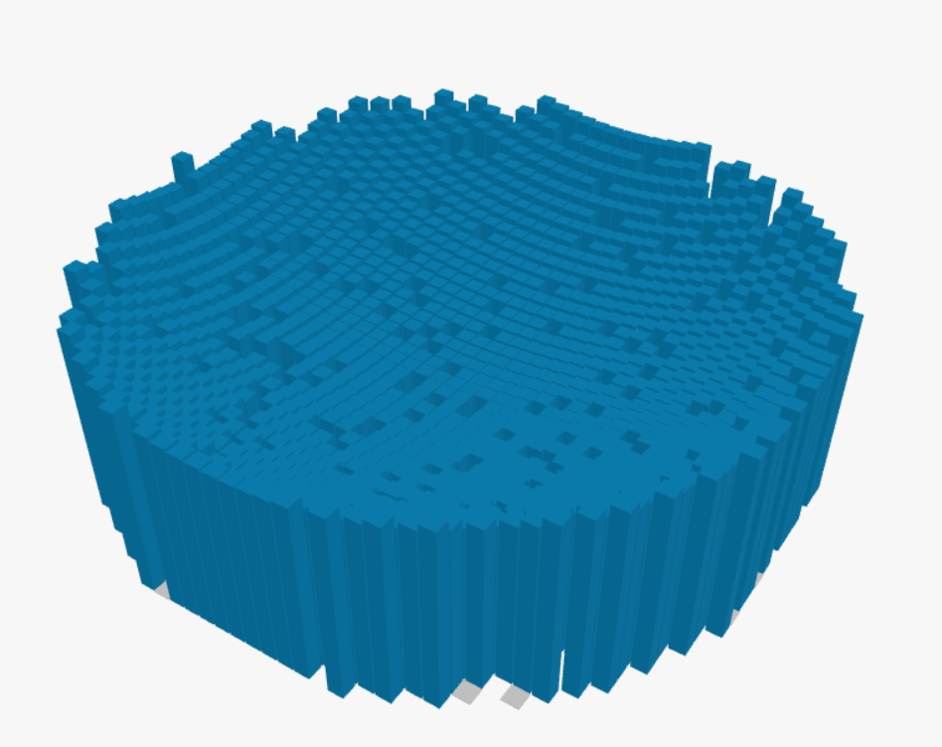
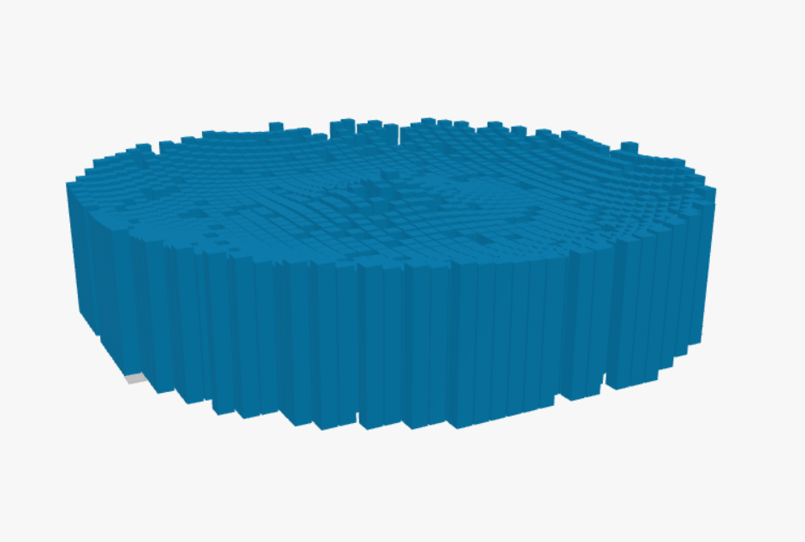
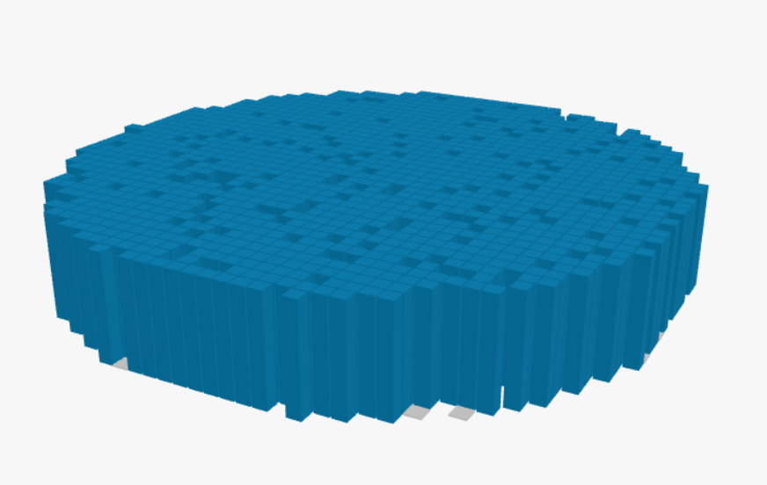
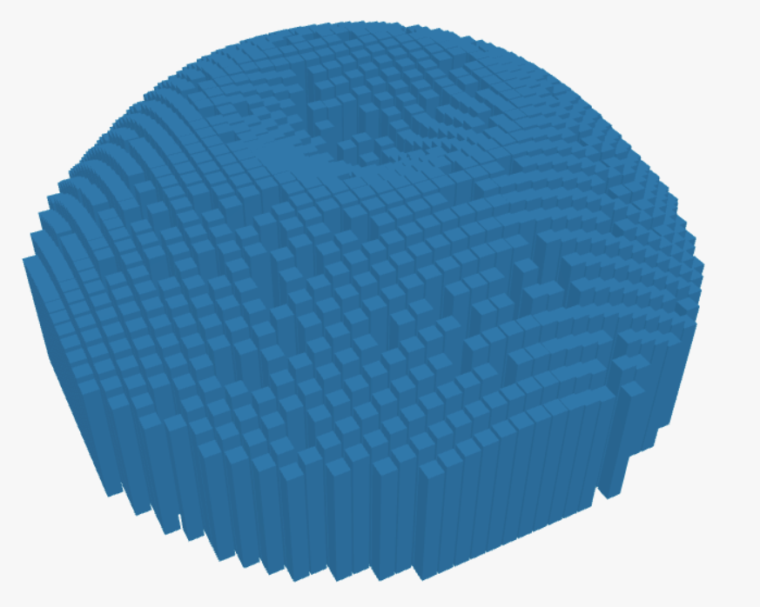
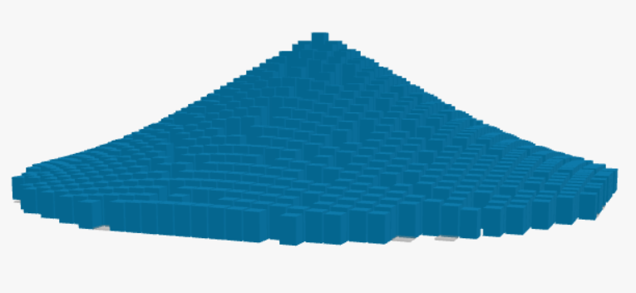


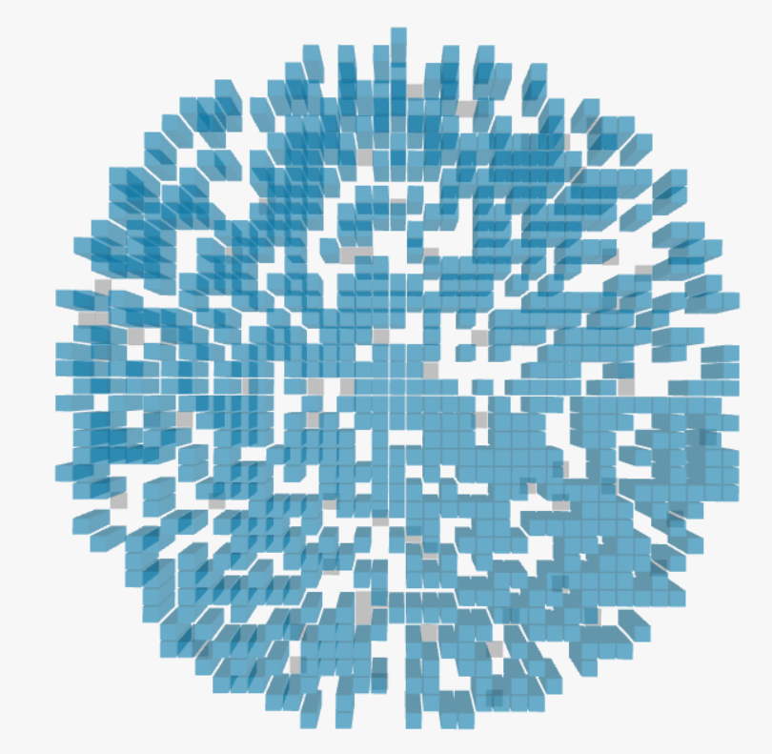
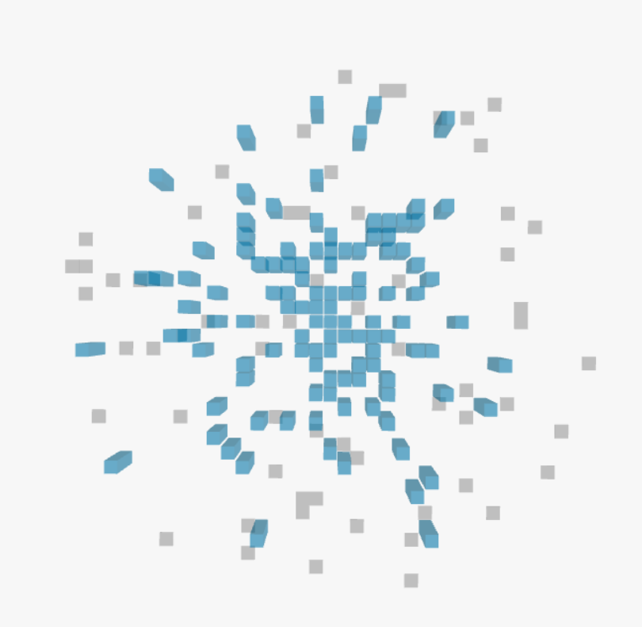
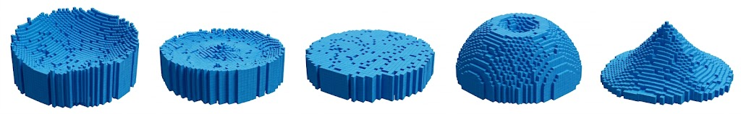
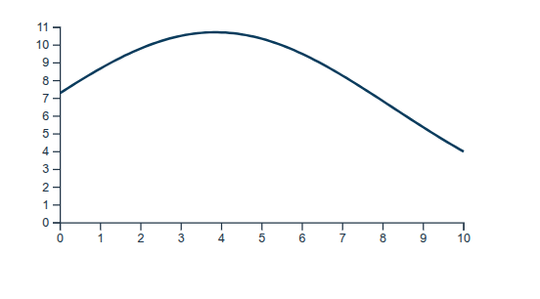
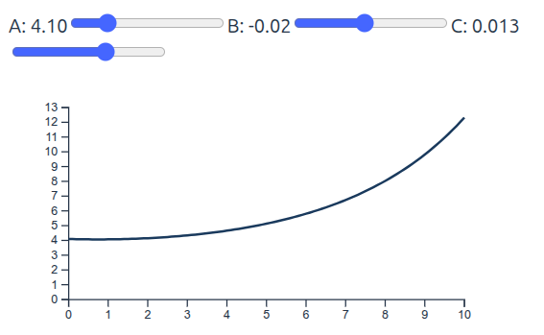
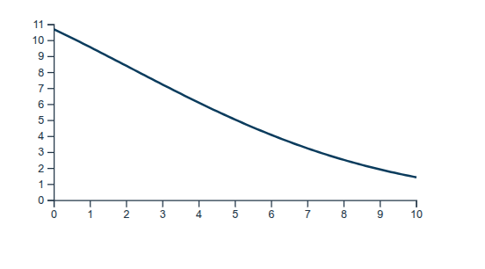



(a) Horizontal Constraints Types
Structural Zeros (cannot be constructed)
Constructable Area
$$ψ\left(r\right)=logistic(α+β∙r)$$
Vertical Profile Types
$α$ small, $β$small
$α$ small, $β$large
$α$ large, $β$small
$α$ large, $β$large
C>0, B>0
“Bowl” City
C>0, B<0
“Crown”City
C=0, B=0
“Pancake” City
C<0, B>0
“Volcanic Cone” City
C<0, B<0
“Pyramid”City
Uniformly Open
Edge constrained
Uniformly constrained
Locked
H
H
H
H
H
(b) Horizontal Construction Types
0
r
0
r
0
r
0
r
0
r
Buildings
Structural Zeros
Constructable Area
$π (r)=logistic(κ−δ∙r)$
κ small δ small
κ small δ large
κ large δ small
κ large δ large
Uniformly sparse
Thinly built
Uniformly dense
Core-dense
(c) Vertical Profile Types
$$H(r)=A∙exp(Br+Cr^{2})$$
C>0, B>0
“Bowl” City
C>0, B<0
“Crown”City
C=0, B=0
“Pancake” City
C<0, B>0
“Volcanic Cone” City
C<0, B<0
“Pyramid”City
H
H
H
H
H
0
r
0
r
0
r
0
r
0
r

Slide 3
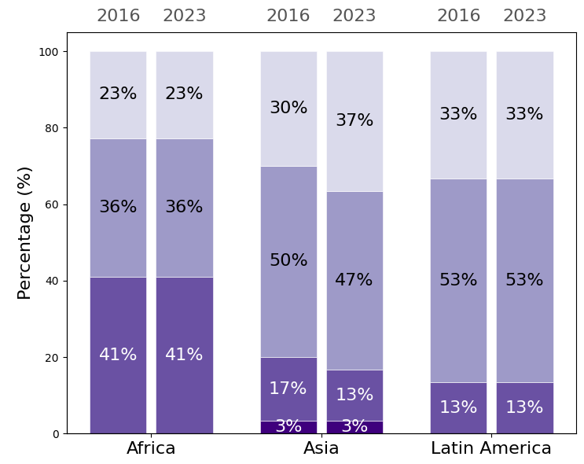
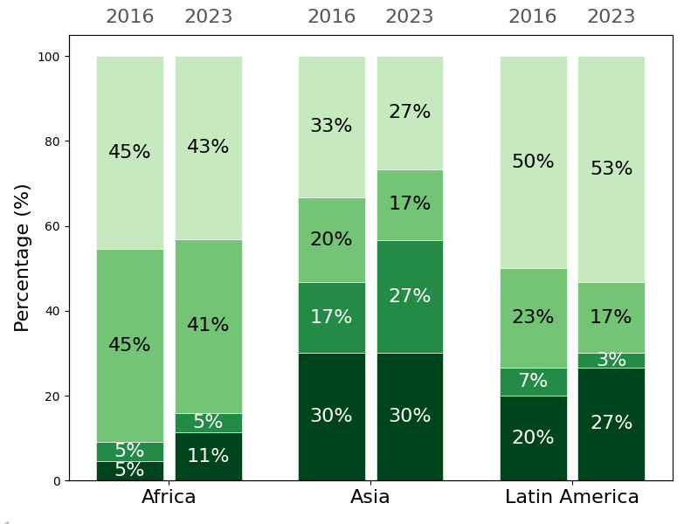



(a) Horizontal Constraints
$$ψ\left(r\right)=\text{logistic}\left(α+βr\right)$$
(b) Horizontal Construction
$$π(r)=logistic(κ−δr)$$
β
Edge-constrianed
45% / 44% (2016 / 2023)
Locked
1% / 1% (2016 / 2023)
δ
Thinly built
32% / 27% (2016 / 2023)
Core-dense
16% / 20% (2016 / 2023)
0.6
0.4
0.3
mean β = 0.3
0.2
mean δ = 0.086
(a) Horizontal Constraint
$$ψ\left(r\right)=\text{logistic}\left(α+βr\right)$$
(b) Horizontal Construction
$$π(r)=logistic(κ−δr)$$
β
Edge-constrianed
45% / 44% (2016 / 2023)
Locked
1% / 1% (2016 / 2023)
δ
Thinly built
32% / 27% (2016 / 2023)
Core-dense
16% / 20% (2016 / 2023)
0
Uniformly open
28% / 30% (2016 / 2023)
Uniformly constrianed
26% / 25% (2016/2023)
0
Uniformly sparse
43% / 41% (2016 / 2023)
Uniformly dense
9% / 12% (2016 / 2023)
0.6
0.4
0%
50%
100%
20%
50%
70%
probability(α)
probability(κ)
Africa, 2016
South & Southeast Asia, 2016
Latin America, 2016
Africa, 2023
South & Southeast Asia, 2023
Latin America, 2023
0.3
mean β = 0.3
0.2
mean δ = 0.086
0
Uniformly open
28% / 30% (2016 / 2023)
Uniformly constrianed
26% / 25% (2016/2023)
0
Uniformly sparse
43% / 41% (2016 / 2023)
Uniformly dense
9% / 12% (2016 / 2023)
0%
50%
100%
20%
50%
70%
probability(α)
probability(κ)
Low-Constraint,
Steep-Gradient
High-Constraint, Steep-Gradient
Low-Intensity, Flat-Gradient
High-Intensity, Flat-Gradient
Africa, 2016
South & Southeast Asia, 2016
Latin America, 2016
Africa, 2023
South & Southeast Asia, 2023
Latin America, 2023
Low-Constraint, Flat-Gradient
High-Constraint, Flat-Gradient
Low-Intensity, Steep-Gradient
High-Intensity, Steep-Gradient
Africa Mean, 2016
South&South-east Asia Mean, 2016
Latin America Mean, 2016
Africa Mean, 2023
South&South-east Asia Mean, 2023
Latin America Mean, 2023
Horizontal Construction Params
(c) Horizontal Constraint Types
(d) Horizontal Construction Types
Africa
South & SE Asia
Latin America
Africa
South & SE Asia
Latin America
Uniformly open
Uniformly constrained
Uniformly sparse
Uniformly dense
Edge constrained
Locked
Thinly built
Core-dense

Slide 4
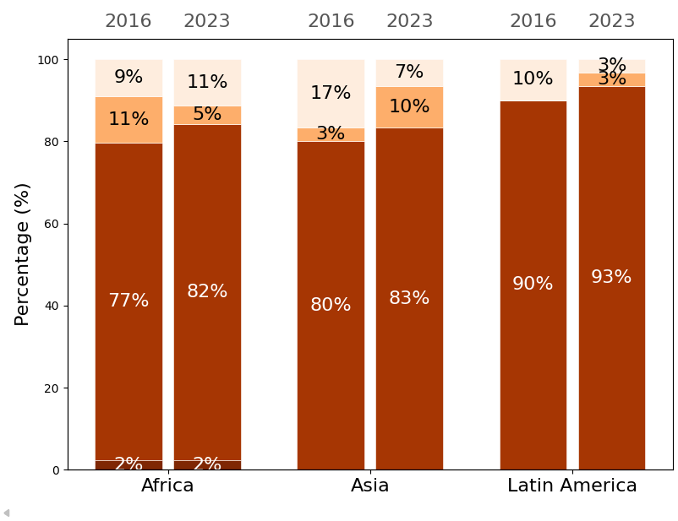
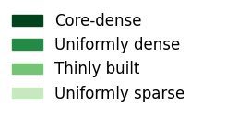
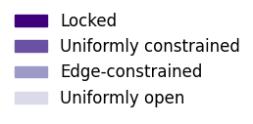
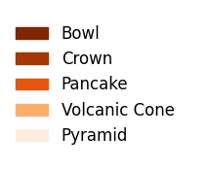
Vertical Profile Types
Pyramid
Volcanic Cone
Pancake
Crown
Bowl
(a) Horizontal Constraint Types
(b) Horizontal Construction Types
（c) Vertical Profile Types
Africa
South & SE Asia
Latin America
Africa
South & SE Asia
Latin America
Africa
South & SE Asia
Latin America
Uniformly open
Uniformly constrianed
Uniformly sparse
Uniformly dense
Pyramid
Pancake
Bowl
Edge constrained
Locked
Thinly built
Core-dense
Volcanic Cone
Crown

Slide 5
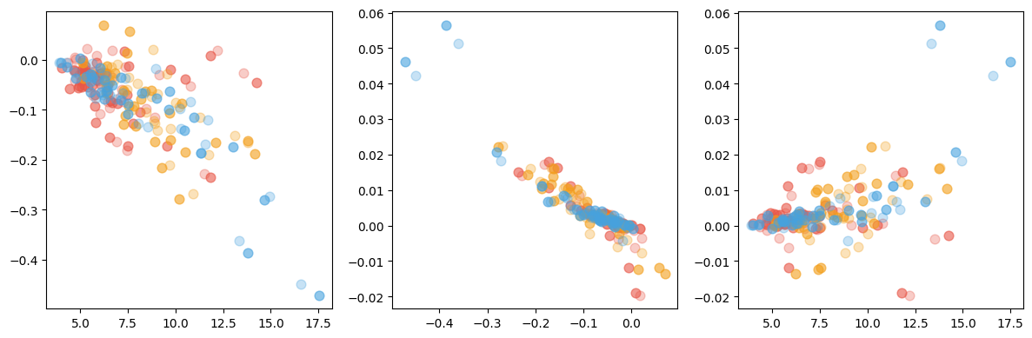



Vertical - Height
$$H(r)=A∙exp(Br+Cr^{2})$$
C
C>0, B>0
“Bowl” City
B
0.06
C
0.06
0
0.04
0.04
-0.2
0.02
0.02
0
C>0, B<0
“Crown”City
0
-0.4
C<0, B<0
“Pyramid”City
5
10
15
-0.02
-0.02
A(m)
-0.4
-0.2
0
B
5
10
15
A(m)
Africa, 2016
South&South-east Asia, 2016
C<0, B>0
“Volcanic Cone” City
Latin America, 2016
Africa, 2023
South&South-east Asia, 2023
Latin America, 2023
(a) Vertical Profile: Gradient B - Curvature C
$$H(r)=A∙exp(Br+Cr^{2})$$
(b) Vertical Profile: Verticality A
$$H(r)=A∙exp(Br+Cr^{2})$$
C
Crown
82 % / 86% (2016 / 2023)
Bowl
1 % / 1%
(2016 / 2023)
A(m)
2016
2023
2016
2023
2016
2023
0.02
16
12
0
8
-0.02
Pyramid
12 % / 8% (2016 / 2023)
Volcanic Cone
6 % / 6%
(2016 / 2023)
4
-0.3
-0.2
-0.1
0
B
Africa
South & Southeast Asia
Latin America
Africa, 2016
South & Southeast Asia, 2016
Latin America, 2016
Africa, 2023
South & Southeast Asia, 2023
Latin America, 2023

Slide 6
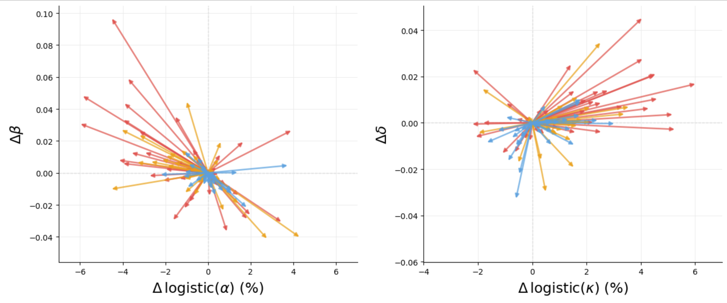
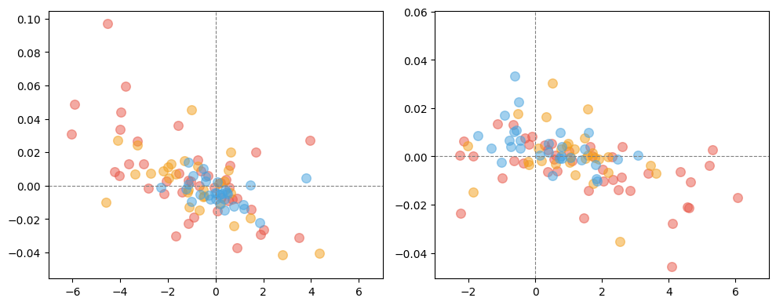


(a) Change of Horizontal Constraint
$$ψ\left(r\right)=\text{logistic}\left(α+βr\right)$$
(b) Change of Horizontal Construction
$$π(r)=logistic(κ−δr)$$
Nouakchott
Δδ
Yaoundé
Δβ
36% p_{α}↓,β↑
12% p_{α}↑,β↑
0.04
8% p_{κ}↓,δ↑
44% p_{κ}↑,δ↑
0.08
Antananarivo
0.04
More even construction
More centralizing construction
Lagos
Constraints more evenly distributed
Edge more constrained than city center
0
0
Jakarta
Phnom Penh
Sao Paulo
-0.04
22% p_{α}↓,β↓
30% p_{α}↑,β↓
-0.04
21% p_{κ}↓,δ↓
27% p_{κ}↑,δ↓
-2%
0%
Δp_{κ}
-6%
0%
Δp_{α}
2%
6%
6%
Less construction at center
More construction at center
Less constraint at center
More constraint at center
Africa
South & Southeast Asia
Latin America

Slide 7
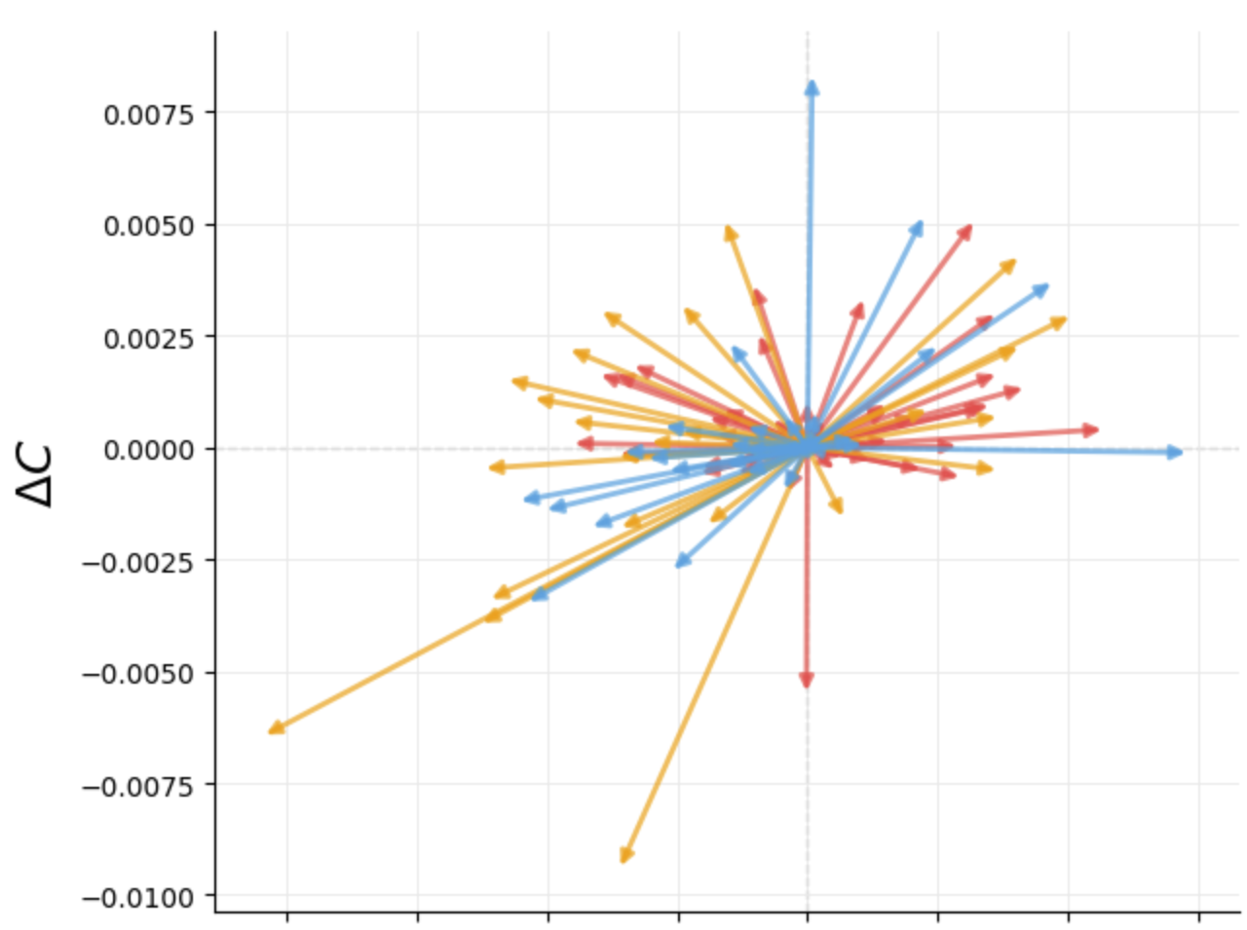
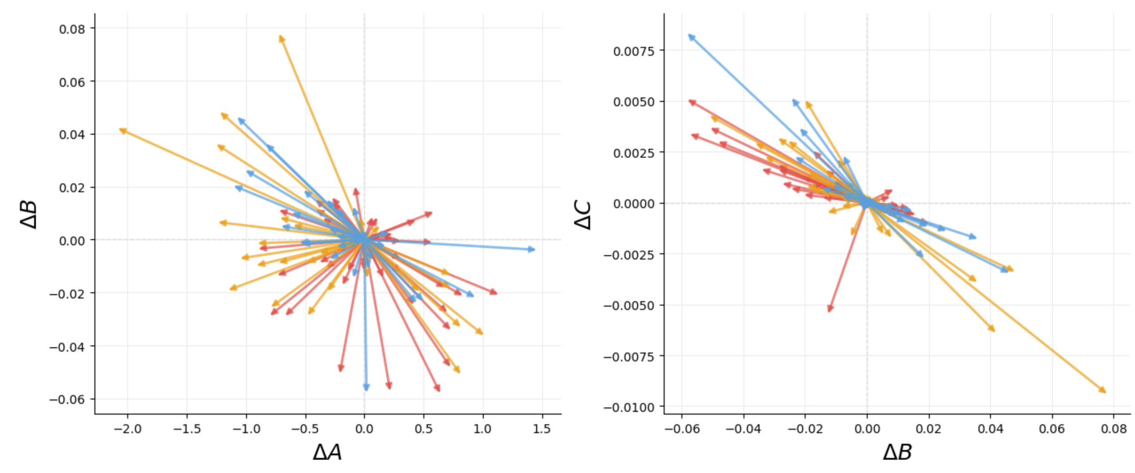
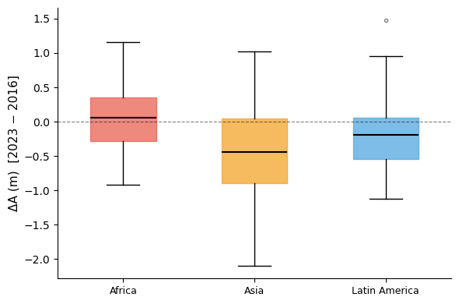
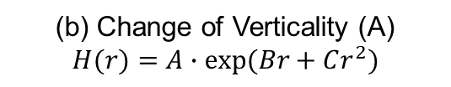
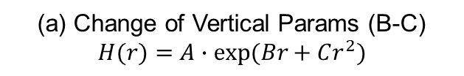
ΔC
0.005
0
-0.005
-2
-1
0
1
ΔA(m)
(a) Change of Vertical Params (B-C)
$$H(r)=A∙exp(Br+Cr^{2})$$
(b) Change of Verticality (A)
$$H(r)=A∙exp(Br+Cr^{2})$$
Towards “Crown”
ΔB<0, ΔC>0 52%
Towards “Bowl”
ΔB>0, ΔC>0 8%
ΔA(m)
ΔB
ΔC
Bogota
52% B↓C↑
0.04
0.005
Nairobi
1
0
0
0
Jakarta
-1
-0.04
-0.005
Towards “Volcanic Cone”
ΔB>0, ΔC<0 33%
-2
-1
0
1
ΔA(m)
Towards “Pyramid”
ΔB<0, ΔC<0 8%
Ahmedabad
-2
-0.04
0
0.04
ΔB
Africa
South & Southeast Asia
Latin America
52% B↓C↑
Africa
South & Southeast Asia
Latin America

Slide 8
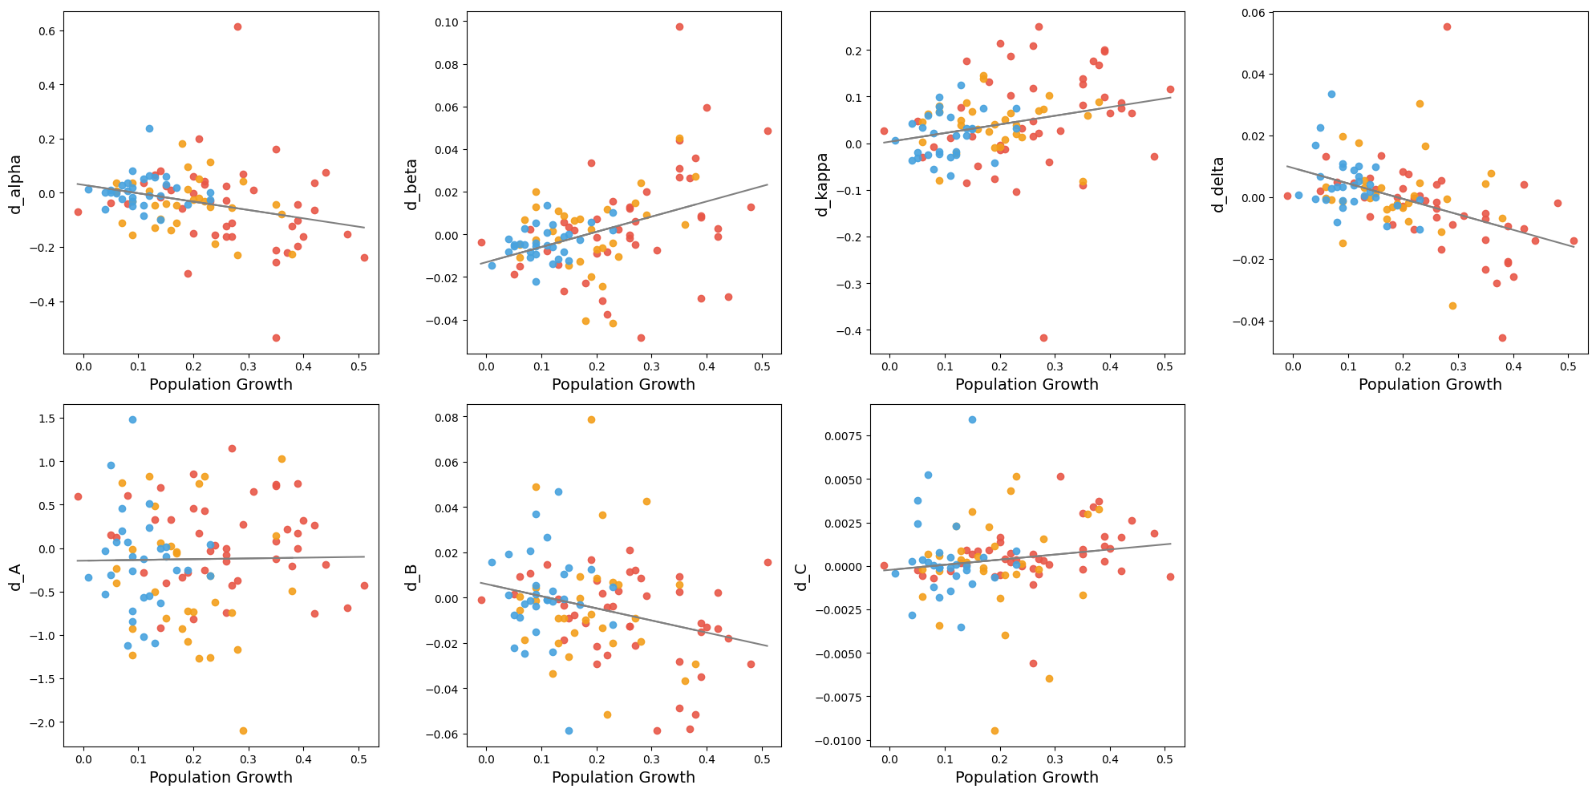
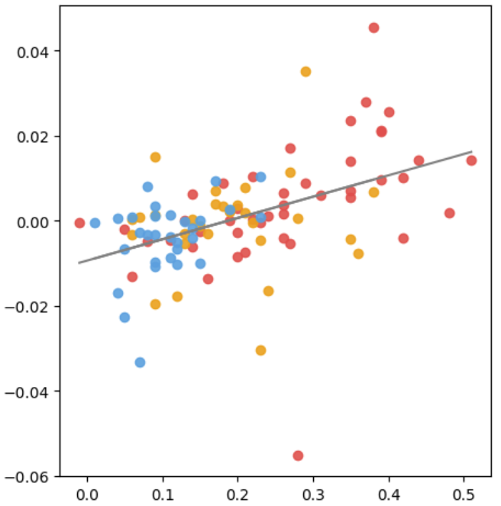
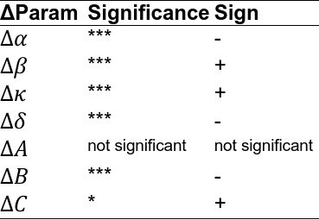






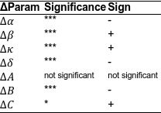

Strong Significance ***
Strong Significance ***
Strong Significance ***
Strong Significance ***
Population growth ↑
→ Δα ↓, Δβ ↑, Δκ ↑, Δδ ↓
→ ΔB ↓, ΔC ↑
ΔParam | Significance | Sign
$$∆α$$ | *** | -
$$∆β$$ | *** | +
$$∆κ$$ | *** | +
$$∆δ$$ | *** | -
$$∆A$$ | not significant | not significant
$$∆B$$ | *** | -
$$∆C$$ | * | +
Not Significant
Strong Significance ***
Significance *
$$∆α$$
$$∆β$$
$$∆κ$$
$$∆δ$$
Pop growth rate
Pop growth rate
Pop growth rate
Pop growth rate
$$∆A$$
$$∆B$$
$$∆C$$
Africa
Pop growth rate
Pop growth rate
Pop growth rate
South & South-east Asia
Latin America

Slide 9
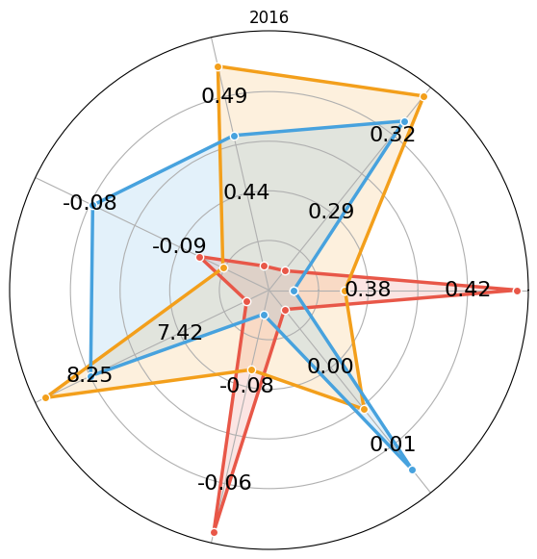
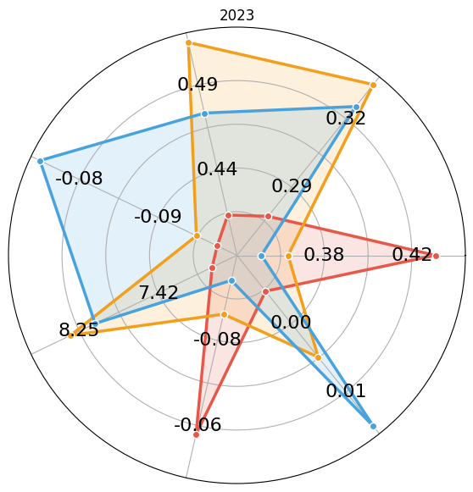








2016
2023
$$prob(κ)$$
$$prob(κ)$$
$$β$$
$$β$$
$$δ$$
$$δ$$
$$prob(α)$$
$$prob(α)$$
$$A$$
$$A$$
$$C$$
Africa
$$C$$
$$B$$
South & South-east Asia
$$B$$
Latin America

Slide 10
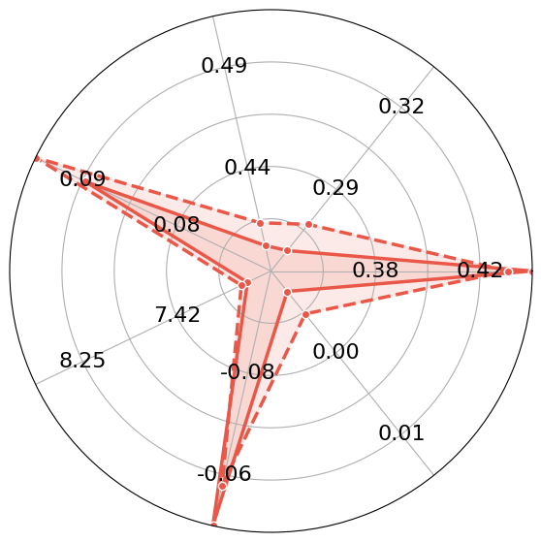
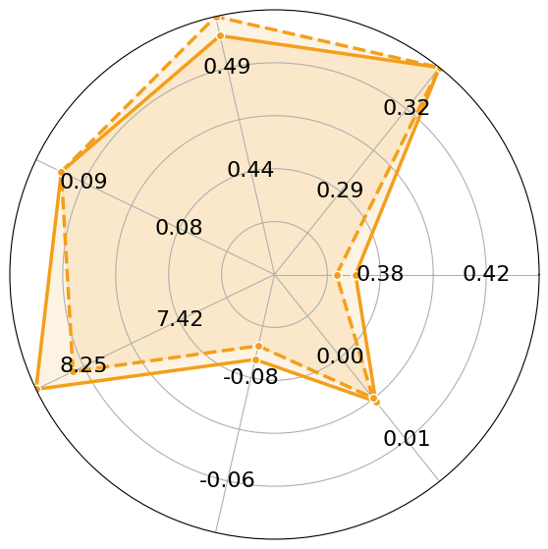
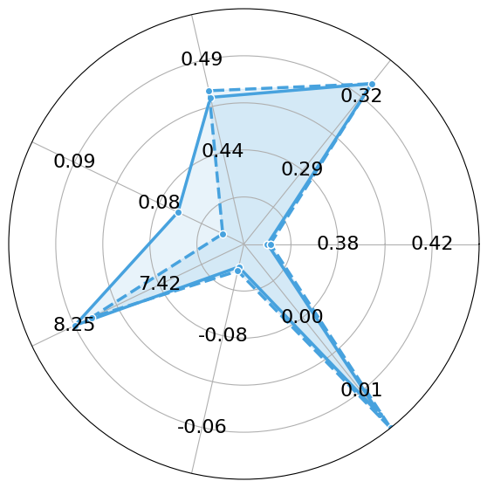




Africa
South & Southeast Asia
Latin America
$$prob(κ)$$
$$β$$
$$prob(κ)$$
$$β$$
$$prob(κ)$$
$$β$$
$$δ$$
$$δ$$
$$δ$$
$$prob(α)$$
$$prob(α)$$
$$prob(α)$$
$$A$$
$$A$$
$$A$$
$$B$$
$$C$$
$$B$$
$$C$$
$$B$$
$$C$$
2016
2023
$$φ(r)=logistic(α+βr)$$
$$H(r)=A∙exp(Br+Cr^{2})$$
$$π(r)=logistic(κ+δr)$$

Slide 11
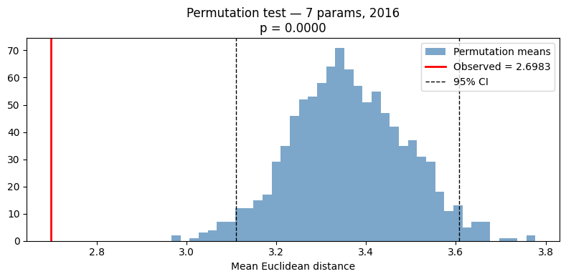
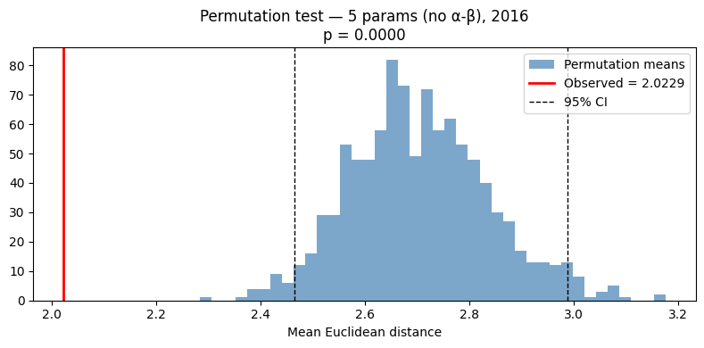
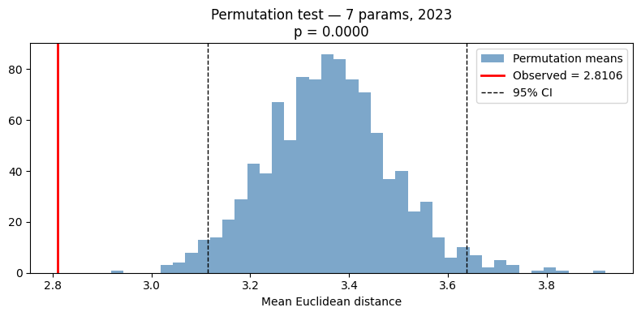

Permutation Tests

Slide 12




Sample Data: Antananarivo, Madagascar
2016
2023
No Building
0
Building Height (pixel)
10 km
100m
Abidjan (2016–2023)

Slide 13



β
Structural Zero Params
$$φ(r)=logistic(α+βr)$$
Actual Construction Params
$$π(r)=logistic(κ+δr)$$
0.6
δ
0
mean δ = -0.09
0.3
mean β = 0.3
-0.2
0
50%
100%
-0.4
20%
50%
70%
Africa, 2016
probability(α)
probability(κ)
South&South-east Asia, 2016
Latin America, 2016
Africa, 2023
South&South-east Asia, 2023
Latin America, 2023
Africa Mean, 2016
South&South-east Asia Mean, 2016
Latin America Mean, 2016
Africa Mean, 2023
South&South-east Asia Mean, 2023
Latin America Mean, 2023

Slide 14



Horizontal Construction Params
β
Structural Zero
$$φ(r)=logistic(α+βr)$$
δ
Actual Construction
$$π(r)=logistic(κ+δr)$$
0.6
Low-Constraint,
Steep-Gradient
High-Constraint, Steep-Gradient
0
Low-Intensity, Flat-Gradient
High-Intensity, Flat-Gradient
mean δ = -0.09
0.3
mean β = 0.3
-0.2
High-Constraint, Flat-Gradient
0
Low-Constraint, Flat-Gradient
100%
-0.4
Low-Intensity, Steep-Gradient
High-Intensity, Steep-Gradient
50%
probability(α)
20%
50%
70%
Africa, 2016
South&South-east Asia, 2016
probability(κ)
South&South-east Asia, 2023
Latin America, 2016
Africa, 2023
South&South-east Asia Mean, 2016
Latin America, 2023
Africa Mean, 2016
South&South-east Asia Mean, 2023
Latin America Mean, 2016
Africa Mean, 2023
Latin America Mean, 2023

Slide 15


Vertical Profile Params
$$H(r)=A∙exp(Br+Cr^{2})$$
B
C
C
0.06
mean B = -0.08
0.06
0
mean B = -0.08
0.04
0.04
-0.2
0.02
0.02
-0.4
0
mean C = 0.00
0
mean C = 0.00
mean A
= 7.58
-0.02
-0.02
mean A
= 7.58
5
10
15
A(m)
-0.4
-0.2
0
B
5
10
15
A(m)
Africa, 2016
South&South-east Asia, 2016
Latin America, 2016
Africa, 2023
South&South-east Asia, 2023
Latin America, 2023
Africa Mean, 2016
South&South-east Asia Mean, 2016
Latin America Mean, 2016
Africa Mean, 2023
South&South-east Asia Mean, 2023
Latin America Mean, 2023

Slide 16
Horizontal - Structural Zero Part
Horizontal - Binomial (Real Construction) Part
2016
2023
2016
2023

Slide 17


Buildings
Structural Zeros
Constructable Area
$π (r)=logistic(κ−δ∙r)$
κ small δ small
κ small δ large
κ large δ small
κ large δ large
Uniformly sparse
Thinly built
Uniformly dense
Core-dense
$\text{κ}$: central building presence probability.
δ (delta): decay rate.

Slide 18



(a) Horizontal Constraint Types
(b) Horizontal Construction Types
2016
2023
2016
2023
2016
2023
2016
2023
2016
2023
2016
2023
Africa
South & Southeast Asia
Latin
America
Africa
South & Southeast Asia
Latin
America
α-β Categories
κ-δ Categories
Uniformly Developable
Core-Open, Edge-Locked
Uniformly Sparse
Small-Core, Sparse-Periphery
Uniformly Constrianed
Core-Limited, Edge-Locked
Uniformly Dense
Dense-Core, Sparse-Periphery
Vertical - Height
2016
2023
2016
2023
2016
2023
Africa
South & Southeast Asia
Latin
America
Vertical Profile Categories
High-scale, Crown
Low-scale, Bowl
High-scale, Pyramid
Low-scale, Crown
High-scale, Volcanic
Low-scale, Pyramid
Low-scale, Volcanic

